Slide 1

CENG 789 – Digital Geometry Processing
10- Shape Registration
(aka Rigid-Body Alignment)
Assoc. Prof. Yusuf Sahillioğlu
Computer Eng. Dept, , Turkey

Slide 2
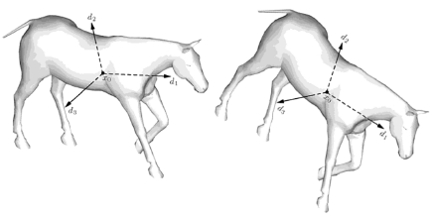
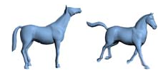
Rigid vs. Non-rigid
<number> / 62
Rigid shapes (mesh, cloud, ..) Non-rigid shapes (mesh, cloud, ..)
(Differ by rigid vs. (Differ by non-rigid transformatns
transformations = rigid + bending + stretching)
= rotation & translation) See Deformation lecture.

Slide 3
Rigid vs. Non-rigid
<number> / 62
Rigid shapes (mesh, cloud, ..) Non-rigid shapes (mesh, cloud, ..)
(Easier to align/register vs. (Harder to align/register
due to low degree- due to high DOF)
of-freedom) See Deformation lecture.

Slide 4
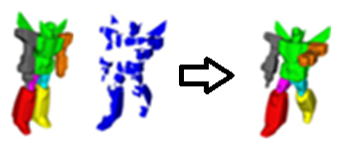
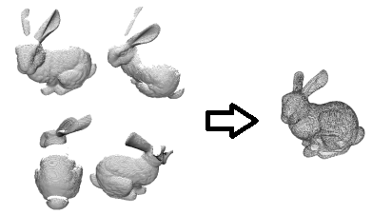
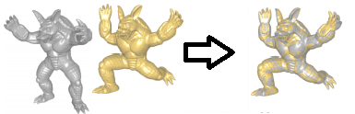
Rigid vs. Non-rigid
<number> / 62
Rigid shapes (mesh, cloud, ..) Non-rigid shapes (mesh, cloud, ..)
(Main app: 3D scan registration) vs. (Main apps: shape completion &
information transfer via shape correspondence)

Slide 5
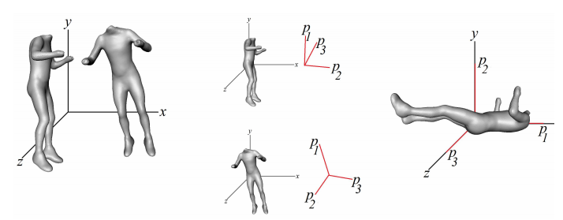
Rigid Alignment via PCA
<number> / 62
We will do rigid-body alignment this lecture.
Easier scenario: Alignment of 2 complete shapes.

Slide 6
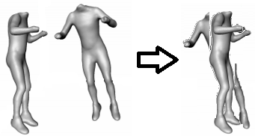
Rigid Alignment via PCA
<number> / 62
We will do rigid-body alignment this lecture.
Easier scenario: Alignment of 2 complete shapes.
Translation disambiguation handled by moving centers to the origin.

Slide 7
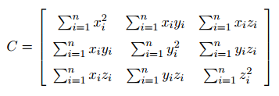
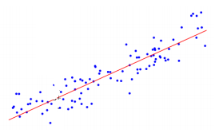


Rigid Alignment via PCA
<number> / 62
We will do rigid-body alignment this lecture.
Easier scenario: Alignment of 2 complete shapes.
Rotation disambiguation handled by PCA.
  PCA on covariance matrix C that encodes an indication of whether 2 attributes, e.g., x-, y-coords, change together or in opposite directions.
  x=1 is above average (0) → increasing
  y=3 is below average (4) → decreasing
  ➔ change in opposite directions (-ve)

Slide 8
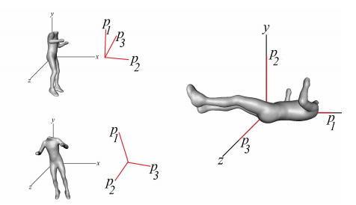
Rigid Alignment via PCA
<number> / 62
We will do rigid-body alignment this lecture.
Easier scenario: Alignment of 2 complete shapes.
Rotation disambiguation handled by PCA.
  PCA on covariance matrix C that encodes an indication of whether 2 attributes, e.g., x-, y-coords, change together or in opposite directions.
  Eigenvectors of C provide principal directions (of variations) of the shape (why? next slide), which are then aligned w/ the Cartesian coordinate axes.
  Same alignment is applied to the 2nd shape.

Slide 9
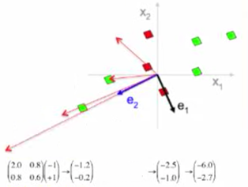
Eigendecomposition of Covariance Matrix
<number> / 62
Why do the eigenvectors of the covariance matrix C give the desired principal directions of variations, i.e., principal components?
Take any vector, e.g., [-1 1]^{T}, transform it via C, get [-1.2 -0.2]^{T}, repeat.
Turns out, multiplying by C spins the initial vector towards direction of the greatest variance. It is also scaled along the way but it’s OK.
So, look for vectors that do not get turned when multiplied by C, hence look for eigenvectors of C.
Eigenvector of a transformation M is a vector that has not changed at all after transformation M except by a scalar known as the eigenvalue: Mv = λv, where v is an eigenvector of M w/ the eigenvalue λ.
Notes:
Nice set of videos on PCA: https://www.youtube.com/playlist?list=PLBv09BD7ez_5_yapAg86Od6JeeypkS4YM

Slide 10
Eigenvector Pop Quiz
<number> / 62
How many eigenvectors does a 2D reflection matrix have, and geometric meaning?
  2: along the reflection line and perpendicular to the reflection line.
Same for i) 3D uniform scaling mtrx? ii) 2D rotation mtr? iii) 3D rot. m?
  Infinitely many: every vector preserves direction and changes magnitude after uniform scaling matrix is applied.
  0: all 2D vectors get turned.
  1: all but 1 (axis of rotation) 3D vectors get turned.
M =
Eigenvector of a transformation M is a vector that has not changed at all after transformation M except by a scalar known as the eigenvalue: Mv = λv, where v is an eigenvector of M w/ the eigenvalue λ. In the example above, λ = 3.

Slide 11

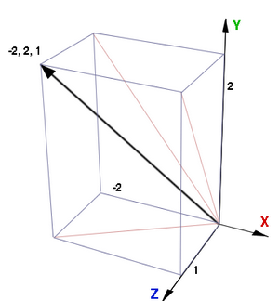
Rigid Alignment via PCA
<number> / 62
How to align principal axes (ready now) w/ Cartesian axes?
Easier scenario: Alignment of 2 complete shapes.
Rotation disambiguation handled by PCA.
  Align principal axes w/ the Cartesian axes; e.g., align black w/ y-axis below.

Slide 12
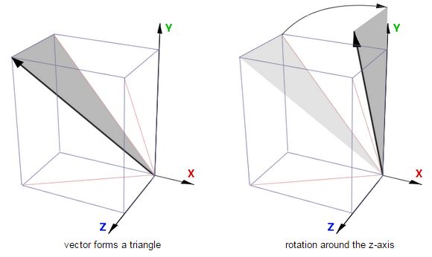
Rigid Alignment via PCA
<number> / 62
How to align principal axes (ready now) w/ Cartesian axes?
Easier scenario: Alignment of 2 complete shapes.
Rotation disambiguation handled by PCA.
  Align principal axes w/ the Cartesian axes; e.g., align black w/ y-axis below.

Slide 13
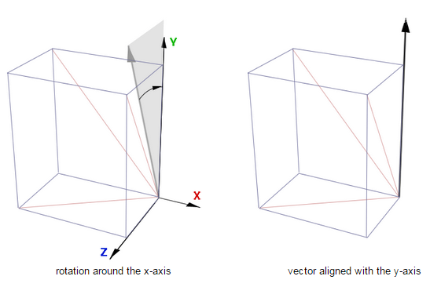
Rigid Alignment via PCA
<number> / 62
How to align principal axes (ready now) w/ Cartesian axes?
Easier scenario: Alignment of 2 complete shapes.
Rotation disambiguation handled by PCA.
  Align principal axes w/ the Cartesian axes; e.g., align black w/ y-axis below.

Slide 14
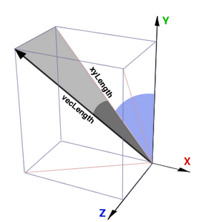
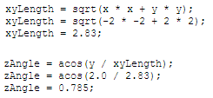
Rigid Alignment via PCA
<number> / 62
How to align principal axes (ready now) w/ Cartesian axes?
Easier scenario: Alignment of 2 complete shapes.
Rotation disambiguation handled by PCA.
  Align principal axes w/ the Cartesian axes; e.g., align black w/ y-axis below.
  Blue (zAngle) and dark (xAngle) angles?

Slide 15

Rigid Alignment via PCA
<number> / 62
How to align principal axes (ready now) w/ Cartesian axes?
Easier scenario: Alignment of 2 complete shapes.
Rotation disambiguation handled by PCA.
  Align principal axes w/ the Cartesian axes; e.g., align black w/ y-axis below.
  Blue (zAngle) and dark (xAngle) angles?

Slide 16
Rigid Alignment via PCA
<number> / 62
How to align principal axes (ready now) w/ Cartesian axes?
Easier scenario: Alignment of 2 complete shapes.
Rotation disambiguation handled by PCA.
  Align principal axes w/ the Cartesian coordinate axes.
  This was cool; but not exactly solving our alignment problem because
    It rather moves object from one position to another within a single reference frame.
    In our case we want switching coordinates from one system (principles) to another (Cartesian); like this:
    Tables, chairs, and other furniture is defined in a local (modeling) coordinate system.
    They can be placed into a room, defined in another coordinate system, by transforming furniture (modeling) coordinates to room (world) coordinates.

Slide 17
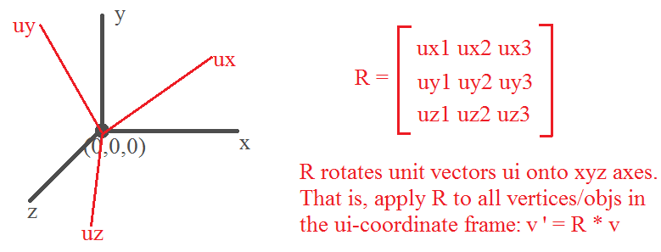
Rigid Alignment via PCA
<number> / 62
How to align principal axes (ready now) w/ Cartesian axes?
Easier scenario: Alignment of 2 complete shapes.
Rotation disambiguation handled by PCA.
  Align principal axes w/ the Cartesian coordinate axes.
  Switching coordinates from one system (principles) to another (Cartesian).

Slide 18
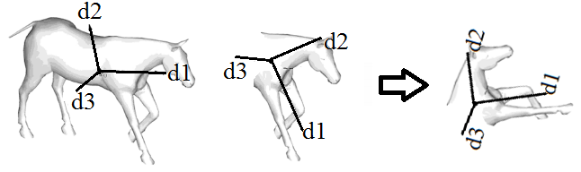
Rigid Alignment via PCA Drawback
<number> / 62
We have a problem w/ this PCA-based scheme.
Harder scenario: Alignment of 2 partial/incomplete shapes.
PCA-based solution is a global approach.
  Based on variations on coordinates.
  Two partially overlapped shapes have different variations; so, PCA fails.

Slide 19
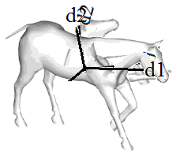
Rigid Alignment via PCA Drawback
<number> / 62
We have a problem w/ this PCA-based scheme.
Harder scenario: Alignment of 2 partial shapes.
PCA-based solution is a global approach.
  Two partially overlapped shapes have different variations; so, PCA fails.
  Depending on the amount of overlap, it may still give a good initialization though, e.g., for ICP (upcoming).

Slide 20
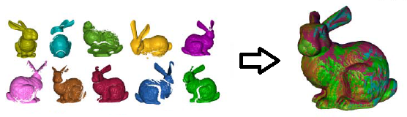
Rigid Alignment with Partial Overlap
<number> / 62
Harder scenario: Alignment of 2 partial shapes.
Partial shapes arise frequently in life: 3D scans.
Handle them using
  Direct rotation computation (when map b/w 2 shapes known).
  Iterative Closest Point algorithm (when map unknown).
  RANSAC (when map unknown).
These methods perform pairwise alignment. Generally have >2 scans.
  Align all other scans to an anchor (impractical-to-find) scan.
  Greedily align each new scan to accumulated alignments (order-dependent).
  Distributing accumulated error is an issue.

Slide 21
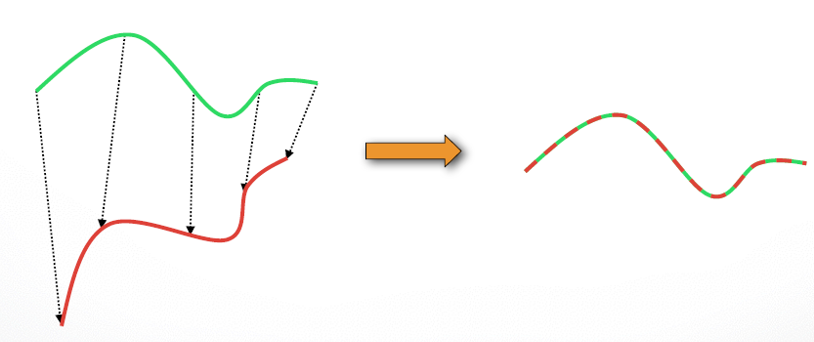
Rigid Alignment w/ the Perfect Map
<number> / 62
If map/correspondences are known, we can derive rotation and translation that aligns the 1st shape with the 2nd.

Slide 22
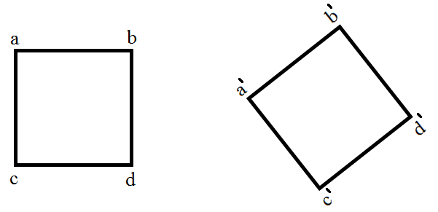
Rigid Alignment w/ the Perfect Map
<number> / 62
If map/correspondences are known, we can derive rotation and translation that aligns the 1st shape with the 2nd.
If correspondences are perfect, you can find the optimal rotation w/ no error.

Slide 23
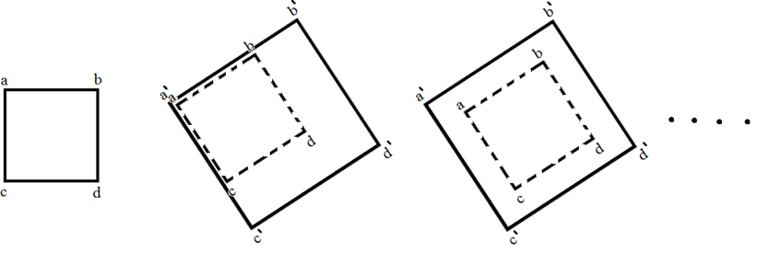
Rigid Alignment w/ Imperfect Map
<number> / 62
If map/correspondences are known, we can derive rotation and translation that aligns the 1st shape with the 2nd.
If correspondences are not perfect, you can find the optimal rotation by minimizing an error.

Slide 24
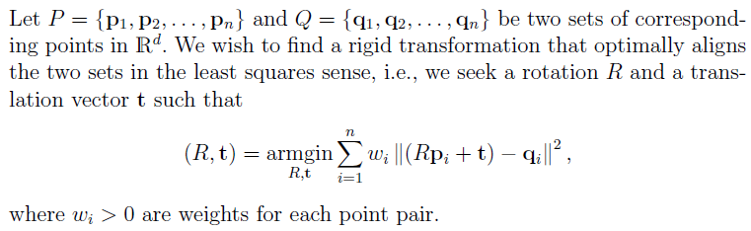
Rigid Alignment w/ Imperfect Map
<number> / 62
If map/correspondences are known, we can derive rotation and translation that aligns the 1st shape with the 2nd.
Note that if correspondences were perfect, no least-squares minimiztn would be necessary; just solve 2 equations:
  R*p1 + t = q1 and R*p2 + t = q2 for the variables R & t.

Slide 25
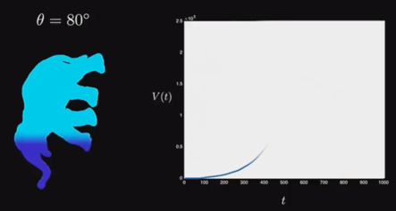
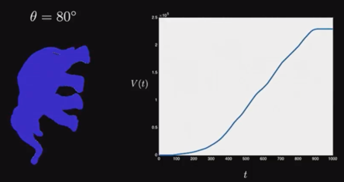
Derivative
<number> / 62
If map/correspondences are known, we can derive rotation and translation that aligns the 1st shape with the 2nd.
Do energy functional minimization using matrix algebra.
  Take the derivative of E(x) w.r.t. x and search for its roots.
  Derivative – What was that? Here is the geometric intuition.
  Volume of the water as we dip the elephant to the tank: monotonically incrsng.

Slide 26
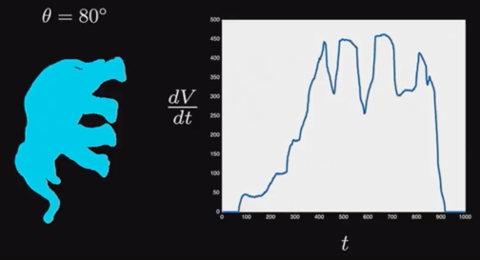
Derivative
<number> / 62
If map/correspondences are known, we can derive rotation and translation that aligns the 1st shape with the 2nd.
Do energy functional minimization using matrix algebra.
  Take the derivative of E(x) w.r.t. x and search for its roots.
  Derivative – What was that? Here is the geometric intuition.
  Derivative is the Rate of Change in water level; how fast the water increasing.
    It never decreases in this scenario so derivative (dV/dt) is always positive.

Slide 27
Derivative
<number> / 62
If map/correspondences are known, we can derive rotation and translation that aligns the 1st shape with the 2nd.
Do energy functional minimization using matrix algebra.
  Take the derivative of E(x) w.r.t. x and search for its roots.
  Derivative – What was that? Here is the geometric intuition.
  Derivative is the Rate of Change in water level; how fast the water increasing.
    V is min when t<80 (not dipped, level=0), max when t>900 (fully dipped, level=2.3x10⁵).
      Special
      places
      where
      derivative
      is zero.

Slide 28
Derivative
<number> / 62
If map/correspondences are known, we can derive rotation and translation that aligns the 1st shape with the 2nd.
Do energy functional minimization using matrix algebra.
  Take the derivative of E(x) w.r.t. x and search for its roots.
  Derivative – What was that? Here is the geometric intuition.
  Derivative is the Rate of Change in water level; how fast the water increasing.
    V increases at same rate around here (dV/dt const). This is a high rate: leg + torso dipped.

Slide 29
Derivative
<number> / 62
If map/correspondences are known, we can derive rotation and translation that aligns the 1st shape with the 2nd.
Do energy functional minimization using matrix algebra.
  Take the derivative of E(x) w.r.t. x and search for its roots.
  Derivative – What was that? Here is the geometric intuition.
  Derivative is the Rate of Change in water level; how fast the water increasing.
    V still increases at but at a slower rate (no leg is dipped, just torso).

Slide 30
Derivative
<number> / 62
If map/correspondences are known, we can derive rotation and translation that aligns the 1st shape with the 2nd.
Do energy functional minimization using matrix algebra.
  Take the derivative of E(x) w.r.t. x and search for its roots.
  Derivative – What was that? Here is the geometric intuition.
  Derivative is the Rate of Change in water level; how fast the water increasing.
    V still increases at but at a slower rate. Still higher than trunk dip ‘cos this is for thick torso.

Slide 31
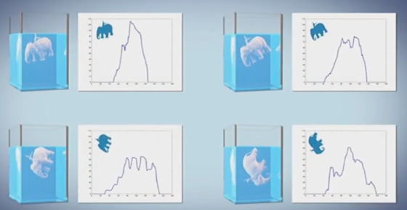
Derivative
<number> / 62
If map/correspondences are known, we can derive rotation and translation that aligns the 1st shape with the 2nd.
Do energy functional minimization using matrix algebra.
  Take the derivative of E(x) w.r.t. x and search for its roots.
  Derivative – What was that? Here is the geometric intuition.
  One can use dV/dt to recognize and reconstruct shape but these are off-topic.
Notes:
See paper: Dip Transform for 3D Shape Reconstruction for details.

Slide 32
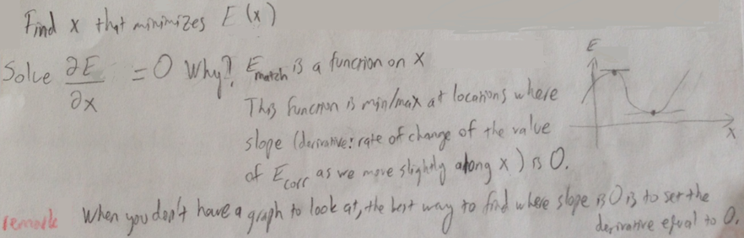
Derivative
<number> / 62
If map/correspondences are known, we can derive rotation and translation that aligns the 1st shape with the 2nd.
Do energy functional minimization using matrix algebra.
  Take the derivative of E(x) w.r.t. x and search for its roots.

Slide 33
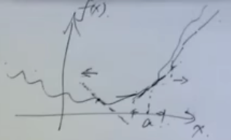
Derivative
<number> / 62
If map/correspondences are known, we can derive rotation and translation that aligns the 1st shape with the 2nd.
Do energy functional minimization using matrix algebra.
  For non-zero derivatives we have ascent directions.
  Sign of the derivative at a is positive (positive slope), meaning that ascend direction is → (go right to make E(x) increase).
  Similarly, derivative here is negative, so ascend direction is ←.
  Note that, on local maxima/minima, there is no ascent direction (slope 0).
  Magnitude of the derivative states how eagerly E(x) wants to go up.

Slide 34
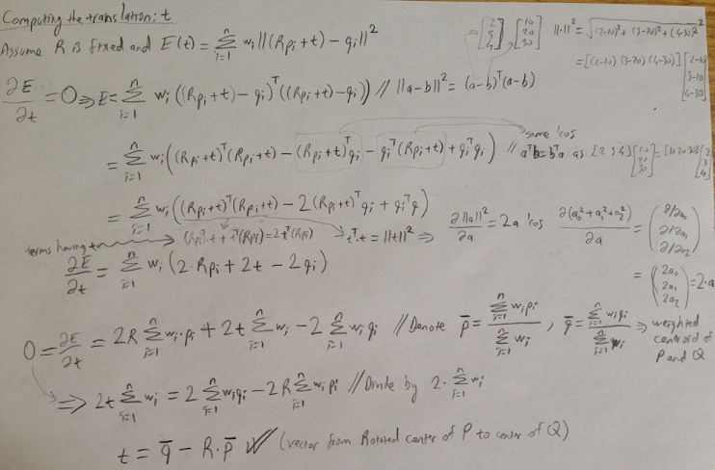
Rigid Alignment Transformations
<number> / 62
Translation.

Slide 35
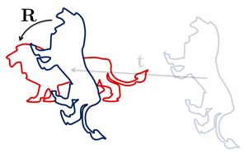
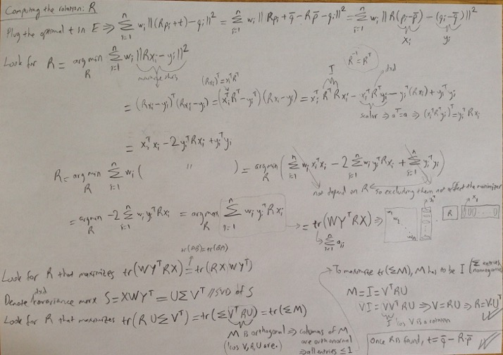
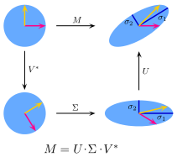

Rigid Alignment Transformations
<number> / 62
Rotation.
First rotate, then translate. Initial points de-meaned.
Recall SVD:
orthogonal unit vectors.
Notes:
https://en.wikipedia.org/wiki/Orthogonal_matrix

Slide 36
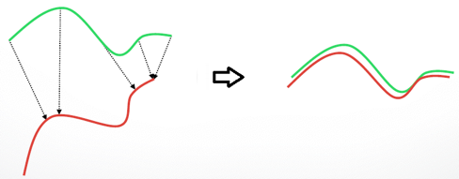
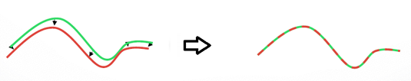
Rigid Alignment via ICP
<number> / 62
  Iterative Closest Point algorithm (when map unknown or imperfect).
    Assume closest points correspond.
    Compute the rotation and translation based on this correspondence/map.
    Update coordinates and re-compute closest-point correspondences.
    Re-compute rotation and translation based on this map. Repeat.

Slide 37
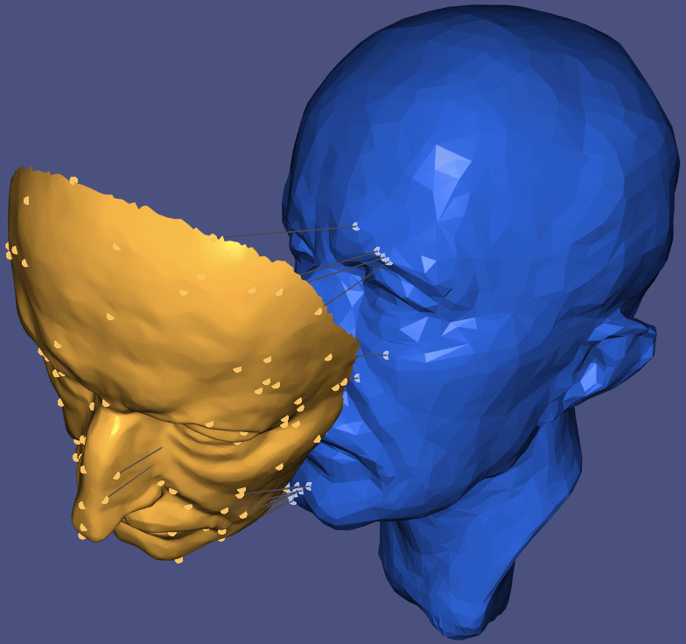
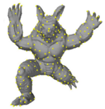
Rigid Alignment via ICP
<number> / 62
  Iterative Closest Point algorithm (when map b/w 2 shapes unknown).
  Original ICP paper (Besl & McKay, A Method for Registration of 3-D Shapes, PAMI, 1992) uses closed-form solution to compute the rotations (unlike our SVD-based solution before – same effect).
  Converges if starting point is close enough.
  GIF from A. Jacobson’s
  Geo. Processing course:
  For efficiency, you can do sampling on point sets. Also, use k-d trees.
  For accuracy, you can replace your matching criteria (point to plane).

Slide 38
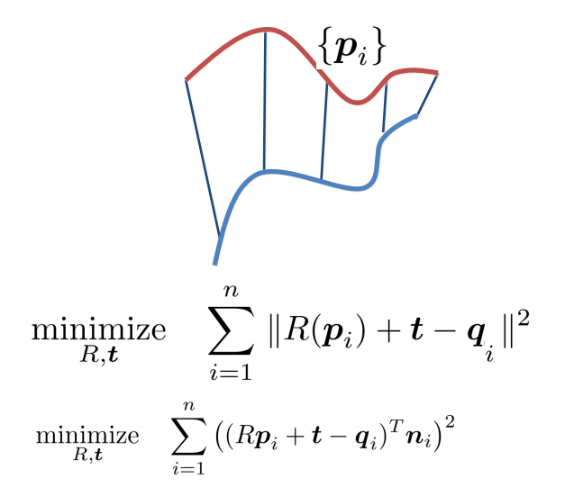
Rigid Alignment via ICP
<number> / 62
ICP variants
  Different error metrics exist.
Point-to-point:
Point-to-plane:

Slide 39
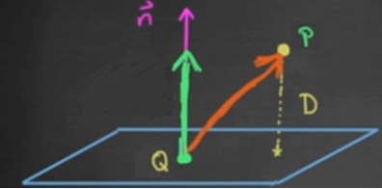



Rigid Alignment via ICP
<number> / 62
ICP variants
  Different error metrics exist.
Point-to-plane:
Point-to-plane derivation: https://www.cs.princeton.edu/~smr/papers/icpstability.pdf
Point-to-point vs. point-to-plane: https://youtu.be/LcghboLgTiA

Slide 40
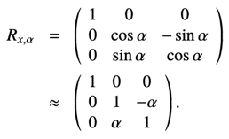
Rigid Alignment via ICP
<number> / 62
ICP variants
  Different error metrics exist.
Approx err increases
as we go up (blue to red).
Point-to-plane derivation: https://www.cs.princeton.edu/~smr/papers/icpstability.pdf
Derivation based on linearization of rotations (OK for small angles).

Slide 41
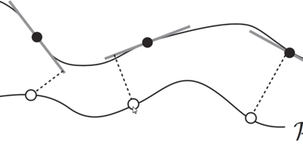
Rigid Alignment via ICP
<number> / 62
ICP variants
  Different error metrics exist.
  Point-to-plane metric shown to do a better job empirically (you
  lose a little bit on the theoretical convergence of the algorithm).
  Best practice is to use a combination: E = .1E_{p2point} + .9E_{p2plane}.

Slide 42
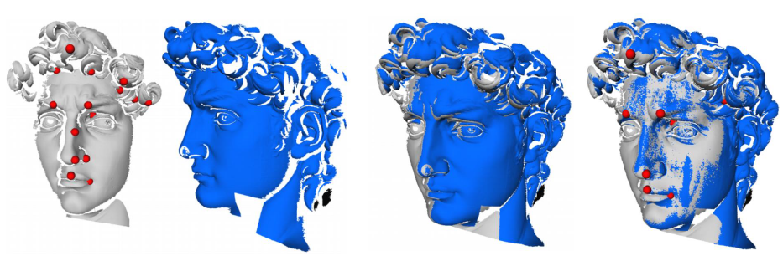
Rigid Alignment via ICP
<number> / 62
  Iterative Closest Point algorithm (when map b/w 2 shapes unknown).
  Resulting ICP session; pretty robust:

Slide 43
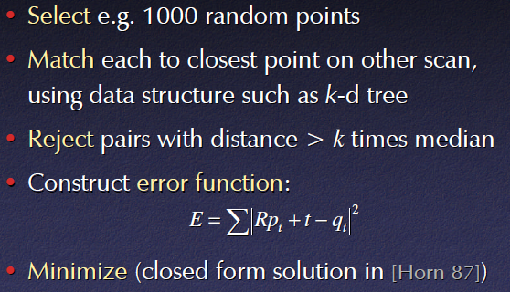
Rigid Alignment via ICP
<number> / 62
  Iterative Closest Point algorithm (when map b/w 2 shapes unknown).
  Basic ICP algo; again:

Slide 44


Rigid Alignment via ICP
<number> / 62
  Iterative Closest Point algorithm (when map b/w 2 shapes unknown).
  Basic ICP algo; again:
  Random sampling can be improved by getting diversity of normals.
    Have equal number of points for each possible normal.
    If careless, stuff on large surface will overwhelm the small surface.
      Here shape is sliding along the large surface (horizontal) ‘cos registration error there is 0. Small surface (vertical) does not warn us due to lack of samples.

Slide 45


Rigid Alignment via ICP
<number> / 62
  Iterative Closest Point algorithm (when map b/w 2 shapes unknown).
  Basic ICP algo; again:
  For the rotation R in ,
  one can use the closed formula (original Besl’92 paper):
  or the SVD-based energy minimization described in Slide 35.

Slide 46
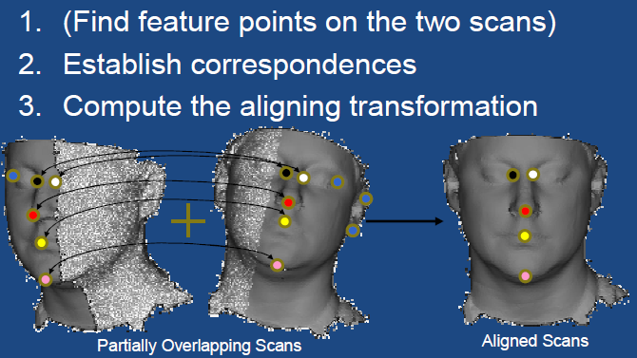
Rigid Alignment via ICP
<number> / 62
  Iterative Closest Point algorithm (when map b/w 2 shapes unknown).
  Better correspondence estimation via feature points.

Slide 47
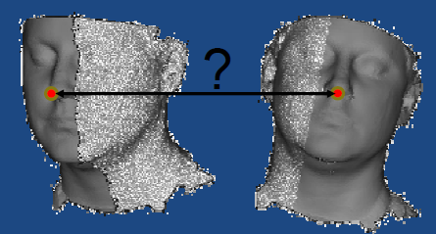
Rigid Alignment via ICP
<number> / 62
  Iterative Closest Point algorithm (when map b/w 2 shapes unknown).
  Better correspondence estimation via feature points.
  Goal is to identify when 2 points on different scans represent the same feature.
  If this is done perfectly, you do not need to iterate (ICP). You just compute rotations and translations in one shot.

Slide 48
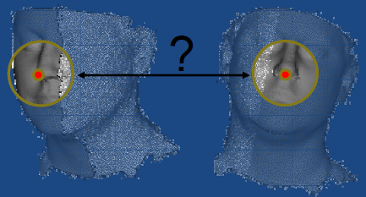
Rigid Alignment via ICP
<number> / 62
  Iterative Closest Point algorithm (when map b/w 2 shapes unknown).
  Better correspondence estimation via feature points.
  Goal is to identify when 2 points on different scans represent the same feature.
  Hint: Are the surroundings similar?

Slide 49
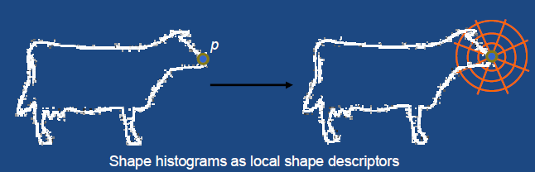
Rigid Alignment via ICP
<number> / 62
  Iterative Closest Point algorithm (when map b/w 2 shapes unknown).
  Better correspondence estimation via feature points.
  Goal is to identify when 2 points on different scans represent the same feature.
  Hint: Are the surroundings similar?
  Recall rotation-invariant shape histograms descriptor.

Slide 50
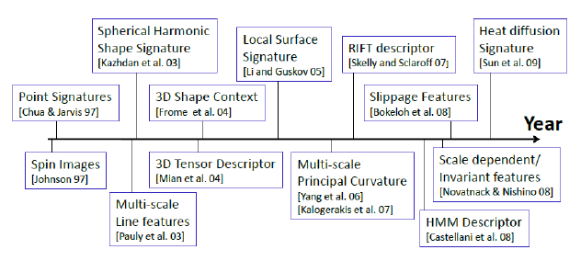
Rigid Alignment via ICP
<number> / 62
  Iterative Closest Point algorithm (when map b/w 2 shapes unknown).
  Better correspondence estimation via feature points.
  Goal is to identify when 2 points on different scans represent the same feature.
  Hint: Are the surroundings similar?
  Lots of descriptors defined over the years.

Slide 51
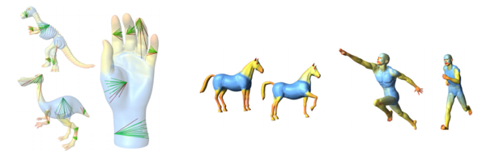

Rigid Alignment via ICP
<number> / 62
  Iterative Closest Point algorithm (when map b/w 2 shapes unknown).
  Better correspondence estimation via feature points.
  Goal is to identify when 2 points on different scans represent the same feature.
  Hint: Are the surroundings similar?
  Shape diameter function (mild non-rigid support), spin images, etc.

Slide 52


Rigid Alignment via ICP
<number> / 62
  Iterative Closest Point algorithm (when map b/w 2 shapes unknown).
  Better correspondence estimation via feature points.
  Goal is to identify when 2 points on different scans represent the same feature.
  Hint: Are the surroundings similar?
  Do not match two close points if their normals are too different.
  x

Slide 53

Rigid Alignment via ICP
<number> / 62
  Iterative Closest Point algorithm (when map b/w 2 shapes unknown).
  Better correspondence estimation via feature points.
  Goal is to identify when 2 points on different scans represent the same feature.
  Hint: Are the surroundings similar?
  Do not match two close points if they are on the boundaries (blacks).
  Do not match two close points if the closeness is not satisfactory.

Slide 54
Rigid Alignment via RANSAC
<number> / 62
  RANSAC (when map b/w 2 shapes unknown).
  ICP only needs 3 point pairs to define a rotation in 3D.
  Brute force. Try all triplets in one shape (C(N,3)) with a base triplet on the other one: O(N³). Repeat this for L different base triplets: O(LN³).

Slide 55

Rigid Alignment via RANSAC
<number> / 62
  RANSAC (when map b/w 2 shapes unknown).
  ICP only needs 3 point pairs to define a rotation in 3D.
  RANSAC algo.
    Pick a random pair of 3 points on 2 shapes.
    Estimate alignment (compute rotation translation) in the least-squares sense.
    Check for the error of this alignment (e.g. sum of distnces b/w matching pnts).

Slide 56

Rigid Alignment via RANSAC
<number> / 62
  RANSAC (when map b/w 2 shapes unknown).
  ICP only needs 3 point pairs to define a rotation in 3D.
  RANSAC algo.
    Pick a random pair of 3 points on 2 shapes.
    Estimate alignment (compute rotation translation) in the least-squares sense.
    Check for the error of this alignment (e.g. sum of distnces b/w matching pnts).

Slide 57

Rigid Alignment via RANSAC
<number> / 62
  RANSAC (when map b/w 2 shapes unknown).
  ICP only needs 3 point pairs to define a rotation in 3D.
  RANSAC algo.
    Pick a random pair of 3 points on 2 shapes.
    Estimate alignment (compute rotation translation) in the least-squares sense.
    Check for the error of this alignment (e.g. sum of distnces b/w matching pnts).

Slide 58

Rigid Alignment via RANSAC
<number> / 62
  RANSAC (when map b/w 2 shapes unknown).
  ICP only needs 3 point pairs to define a rotation in 3D.
  RANSAC algo.
    Pick a random pair of 3 points on 2 shapes.
    Estimate alignment (compute rotation translation) in the least-squares sense.
    Check for the error of this alignment (e.g. sum of distnces b/w matching pnts).

Slide 59

Rigid Alignment via RANSAC
<number> / 62
  RANSAC (when map b/w 2 shapes unknown).
  ICP only needs 3 point pairs to define a rotation in 3D.
  RANSAC algo.
    Pick a random pair of 3 points on 2 shapes.
    Estimate alignment (compute rotation translation) in the least-squares sense.
    Check for the error of this alignment (e.g. sum of distnces b/w matching pnts).
    Random picks do not
    have to be perfect matches.

Slide 60

Rigid Alignment via RANSAC
<number> / 62
  RANSAC (when map b/w 2 shapes unknown).
  ICP only needs 3 point pairs to define a rotation in 3D.
  Resulting RANSAC session:

Slide 61

Rigid Alignment via RANSAC
<number> / 62
  RANSAC (when map b/w 2 shapes unknown).
  ICP only needs 3 point pairs to define a rotation in 3D.
  Resulting RANSAC session:

Slide 62


Potential Project Topics
<number> / 62
  ICP more resilient to noisy and missing data; paper: Sparse Iterative Closest Point (traditional way: prune or reweight correspondences).
  Non-rigid ICP to register deforming objects; paper: Robust Articulated-ICP for Real-Time Hand Tracking (Section 4.2 is cool).

